Slide 1
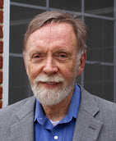
Threads and Concurrency Python Part II

Slide 2
Python Threads

Slide 3
Create a Thread in Python
# create a thread object that executes a function and then terminates t1 = Thread(target=some_function)
# launch the thread t1.start()
How many threads do have in this program?
Answer: 2
When you run any Python program, there is a main thread running the program!

Slide 4
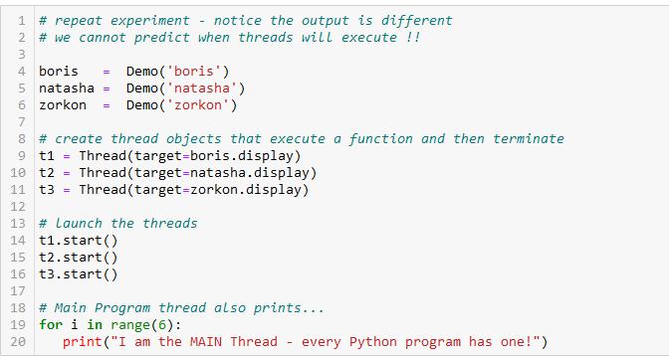
Don't try and outguess the scheduler
I'm the scheduler. Don't try and out-guess me!

Slide 5
Summary
In Python, threads are created via a Thread object that knows (is passed in its constructor) what code to execute
The thread's code begins execution when its start method is called
The scheduler can interrupt the thread's code execution at any time
Each thread maintains its own program counter so it knows where to pick back up when it's interrupted
When it's code is done, the thread is terminated (dies)

